Slide 1
Components

Slide 2
What is a component.
The fundamental building blocks of Blazor applications are components.
Components define a piece of UI, which can be something as small as a button or as large as an entire page. Components can also contain other components. They encapsulate any data that a piece of UI requires to function. They allow a piece of UI to be reused across an application or even shared across multiple applications.
Data can be passed into a component using parameters. Parameters define the public API of a component. The syntax for passing data into a component using parameters is the same as defining attributes on a standard HTML element—with a key-value pair. The key is the parameter name, and the value is the data you wish to pass to the component.
The data a component contains is more commonly referred to as its state. Methods on a component define its logic. These methods manipulate and control that state via the handling of events.

Slide 3

Structuring Components
It is possible to define a component in a single .razor file that contains both its markup and logic. But it is also possible to separate a component into a .razor file that defines the markup and a C# class that defines the logic.
Single File
Single file is the default when creating new components. The entire component is defined in a single .razor file with the markup coming first and the logic coming second, defined in the code block. It is a preferred approach because its makes development faster since you don’t have to switch between files but for the purposes of organization you can consider another approach.
Partial class
Another approach is to split the markup and logic of a component into two separate files. The markup of the component is kept in the .razor file, and the logic is added to a C# class. In earlier versions of Blazor, it was only possible to apply this approach using inheritance, as there was no support for the partial keyword. This is no longer the case.

Slide 4
Working with parent and child components
A great analogy for components is LEGO blocks. Each LEGO block is a self-contained unit, but the real fun comes when you plug the blocks together to build something bigger and better.
This is the same for components. They can be useful on their own, but they are more powerful when used together. When using multiple components, you will soon end up with components that contain other components. These are known as parent and child components.
These components will sometimes need to communicate with each other, such as for pas-sing data and firing and handling events. In Blazor, we achieve this using component parameters. Component parameters are declared on a child component, which forms that component’s API.
A parent component can then pass data to the child using that API. But component parameters can also be used to define events on the child that the parent can handle. This allows data to be passed from the child back up to the parent.

Slide 5
Passing Parameters From Parent to Child
A component parameter is defined as a public property that is decorated with the Parameter attribute. We can even mark certain parameters as required using the EditorRequired attribute with the Parameter attribute, as we have in the child component.
Blazor uses this attribute to find component parameters during the execution of the SetParametersAsync life cycle method we looked at earlier in the chapter. During this life cycle method, the parameter values are set via reflection.
We’re using the OnParametersSet life cycle method to trigger the drawer sliding into view. As we learned earlier, this life cycle method is run every time the component’s parameters change. This makes it perfect for our scenario, as we can use it to trigger opening the drawer.

Slide 6
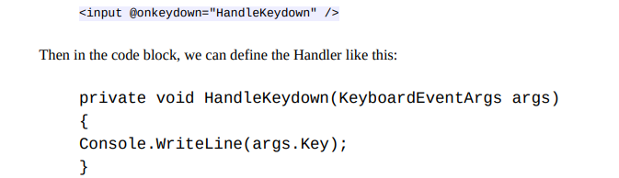
Passing Data from Child to Parent
A parent handling a child component’s event, defined as either Action/Action or Func/Func, must call StateHasChanged manually to trigger any required UI updates. Child components can define their events using the type EventCallback or EventCallback, which will automatically call StateHasChanged on the parent component once the handler has been run
Handling DOM Events
Blazor has its own events system that wraps the standard DOM events, allowing us to work with them natively, in C#. To handle an event, we use the following syntax on an element:
@onEVENTNAME="HANDLER"
EVENTNAME is the name of the event you wish to handle, and HANDLER is the name of the method that will be invoked to handle the event. Blazor will also pass an event argument to the Handler method, which is appropriate for the event. For example, if we wanted to handle the keydown event on an input, we could do so like this:]
For events read : https://learn.microsoft.com/en-us/aspnet/core/blazor/components/event-handling?view=aspnetcore-6.0#event-argument-types

Slide 7
Styling components
There are two approaches to styling components in Blazor:
Global styling
Scoped styling
As you would expect, global styles are classes that are declared on the global scope and can apply to any element that uses that class name or meets the selector for that class. Scoped styles are the opposite. A stylesheet is created for a specific component, and any classes defined in it are made unique to that component using a unique identifier produced during the build process. No matter which of these approaches you take to style your application, it is possible to combine it with CSS preprocessors. CSS preprocessors like Sass allow CSS to be written in a more modular and maintainable way, taking advantage of features such as variables and functions.

Slide 8
Global Styling
Global styling is the default method when building applications. To apply global styling, one or more stylesheets are added to the host page, which, by default, is index.html in Blazor WebAssembly and _Host.cshtml in Blazor Server. The styles defined in those stylesheets are then available throughout the application.
Global styles are fantastic for creating a consistent look and feel across an application. we can change the styles in one place, and the application is immediately updated.
This global scope of styles can also cause some issues when developing larger applications. For example, if we wanted a certain button to be green with square corners rather than the global blue style, we would need to add another style to the stylesheet. We would then need to apply the style to the particular button. That doesn’t seem too bad, but think of this happening many times over—you end up with a stylesheet that is full of one-off styles or niche styles. You could say this is down to bad design or lack of maintenance—which would be fair—but it still doesn’t stop it from happening.
There is also another option that has come about with the rise of SPA frameworks— scoped CSS.

Slide 9
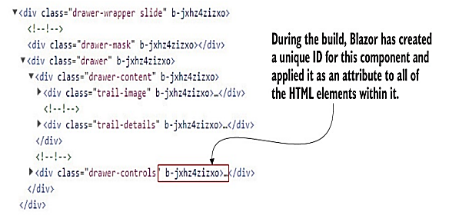
Scoped styling
Scoped styling allows a developer to create styles that affect only a certain component in the application. In Blazor applications, this is done by creating a stylesheet with the same name as the component. During the build process, Blazor generates unique IDs for each component and then the styles for that component are rescoped using each ID.
Scoped styles are created by defining a stylesheet with the naming convention [ComponentName].razor.css.
When using scoped CSS, there will be a lot of stylesheets dotted around the application. Adding each and every one of them to the host page would be tedious and difficult to maintain. So, what Blazor does as part of the build process is bundle all the styles from the various stylesheets into a single stylesheet. This means we just need to reference that one stylesheet in our host page. The file has a naming convention of [ProjectName].styles.css
Each selector for the styles in the TrailDetails.razor.css file has been rewritten to use the unique ID Blazor generated for the component. Doing this is what scopes the style to that component and stops the style affecting another element in another component. As you can see, using scoped styles doesn’t make components immune from the standard behavior of CSS. This is something to think about when deciding how to style your components; mixing global and scoped styles could make things more complicated.

